Slide 17
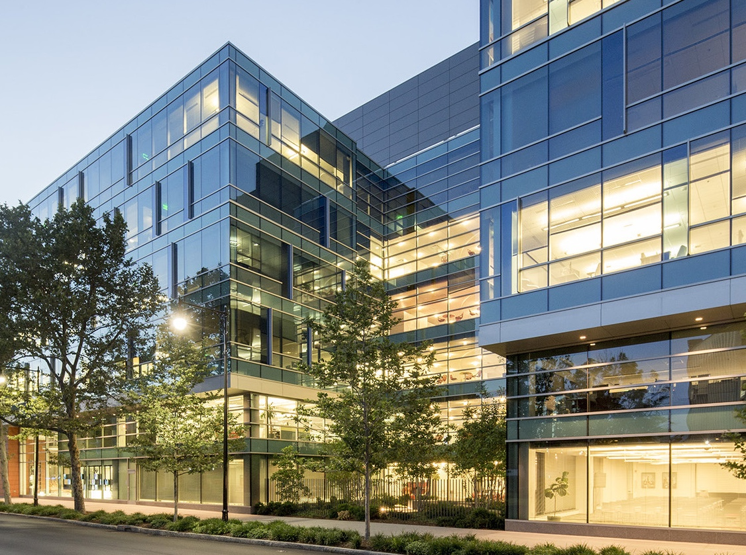

Slide 36
Instructional slide only, do not use
On Title Slides that use photography, copy the logo on this slide and paste it over the photo.
*use this logo on darker imagery
*hide this slide before publishing

Slide 37
Instructional slide only, do not use
On Title Slides that use photography, copy the logo on this slide and paste it over the photo.
*use this logo on lighter imagery
*hide this slide before publishing

Slide 38
Instructional slide only, do not use
If a photo covers the upper right side of a slide, copy the logo from this slide and paste it over the photo.
*use this logo on darker imagery
*hide this slide before publishing

Slide 39
Instructional slide only, do not use
If a photo covers the upper right side of a slide, copy the logo from this slide and paste it over the photo.
*use this logo on lighter imagery
*hide this slide before publishing

